Slide 1
Image detection using R-CNN
Waste Segregation
Presented by:
Shreya Prakash Vikram K

Slide 2
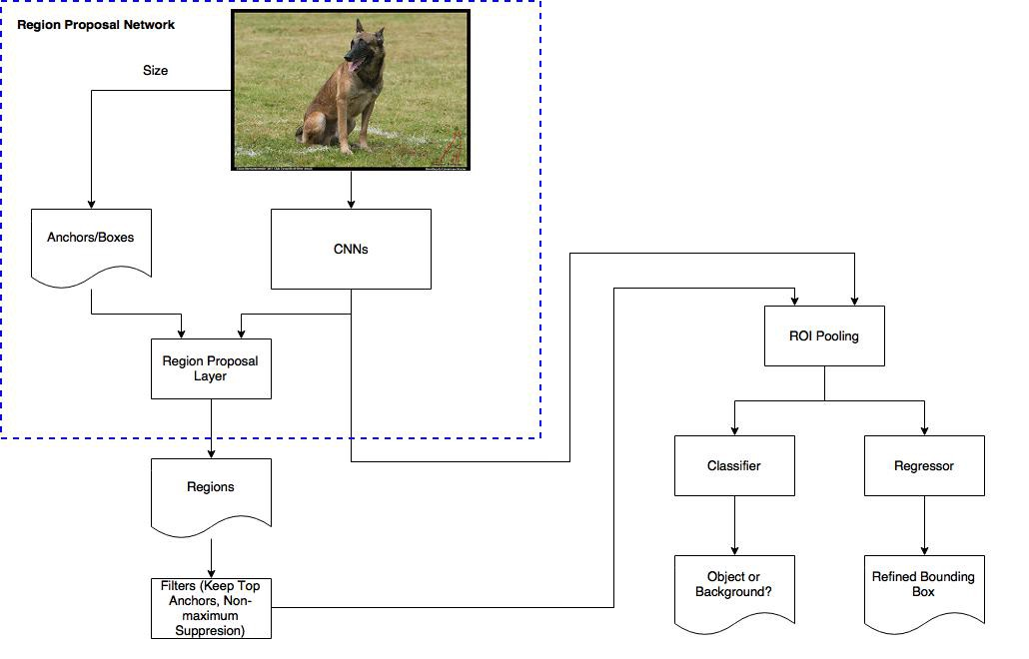
FLOW CHART
Faster R-CNN Structure

Slide 3
Faster R-CNN Model
Faster R-CNN has two networks: region proposal network (RPN) for generating region proposals and a network using these proposals to detect objects.
The time cost of generating region proposals is much smaller in RPN than selective search, when RPN shares the most computation with the object detection network.
Briefly, RPN ranks region boxes (called anchors) and proposes the ones most likely containing objects. The architecture is as follows.

Slide 4
THE CONVOLUTION STEP
CONVOLUTIONAL NEURAL NETWORKS
The primary purpose of Convolution is to extract features from the input image. Convolution preserves the spatial relationship between pixels by learning image features using small squares of input data.
Every image can be considered as a matrix of pixel values. Consider a 5 x 5 image whose pixel values are only 0 and 1 (note that for a grayscale image, pixel values range from 0 to 255, the green matrix below is a special case where pixel values are only 0 and 1). Also, consider another 3 x 3 matrix
Then, the Convolution of the 5 x 5 image and the 3 x 3 matrix can be computed as shown

Slide 5
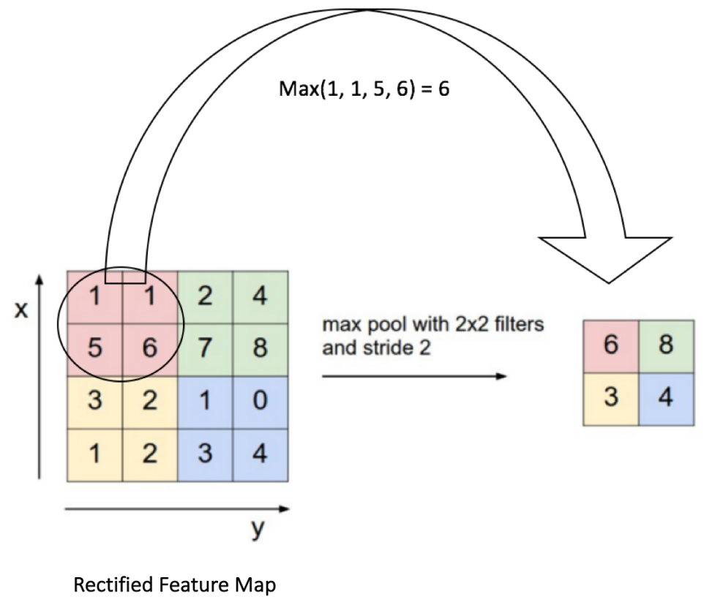
THE POOLING STEP
Spatial Pooling (also called subsampling or down sampling) reduces the dimensionality of each feature map but retains the most important information. Spatial Pooling can be of different types: Max, Average, Sum etc.
In case of Max Pooling, we define a spatial neighborhood (for example, a 2×2 window) and take the largest element from the rectified feature map within that window. Instead of taking the largest element we could also take the average (Average Pooling) or sum of all elements in that window. In practice, Max Pooling has been shown to work better.
The Figure shows an example of Max Pooling operation on a Rectified Feature map by using a 2×2 window.

Slide 6
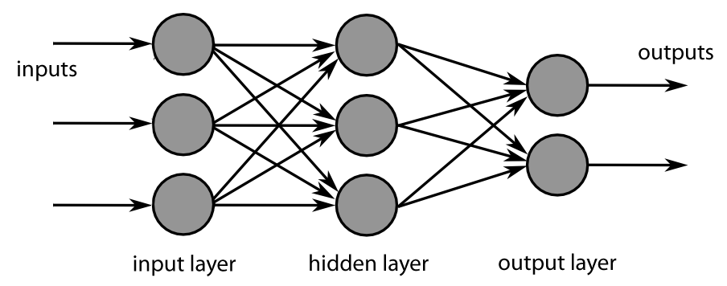
FULLY CONNECTED LAYER
The final layers of the CNN are densely connected layers, or an artificial neural network (ANN). The primary function of the ANN is to analyze the input features and combine them into different attributes that will assist in classification. These layers are essentially forming collections of neurons that represent different parts of the object in question, and a collection of neurons may represent the floppy ears of a dog or the redness of an apple. When enough of these neurons are activated in response to an input image, the image will be classified as an object
The neurons in the middle fully connected layers will output binary values relating to the possible classes. If you have four different classes (let's say a dog, a car, a house, and a person), the neuron will have a "1" value for the class it believes the image represents and a "0" value for the other classes.

Slide 7
REGION PROPOSAL NETWORK
The output of a region proposal network (RPN) is a bunch of boxes/proposals that will be examined by a classifier and regressor to eventually check the occurrence of objects. To be more precise, RPN predicts the possibility of an anchor being background or foreground, and refine the anchor.
ROI POOLING
After RPN, we get proposed regions with different sizes. Different sized regions means different sized CNN feature maps. It’s not easy to make an efficient structure to work on features with different sizes. Region of Interest Pooling can simplify the problem by reducing the feature maps into the same size.

Slide 8
Client Program
Language chosen : Visual Basic
Language intent : For UI building
Visual Basic is a third-generation event-driven programming language from Microsoft for its Component Object Model (COM)
Programming in VB is a combination of visually arranging components or controls on a form, specifying attributes and actions for those components, and writing additional lines of code for more functionality.

Slide 9
Language 2 for DLL
C-Sharp (C#) is the language used for Dll.
C# (C-Sharp) is a programming language developed by Microsoft that runs on the .NET Framework.
It is used to develop web apps, desktop apps, mobile apps, games and much more.
DATASET : We have created our dataset which consists various images 6 objects currently.
i.e.
Apple 2) Orange 3) Banana 4) Plastic bottle 5) Cardboard box 6) Metal tin
Preparing Dataset: We have built the classifier which detects the above mentioned categories. The dataset is the most important thing in building a classifier. This will be the basis of our classifier on which object detection is done.
We have Collected as many different and variety of images consisting of the objects. The more the number of images the better is the precision of the classifier.
The Tool used to label the images is Labelimg. This tool helps us to draw boxes around the image and label it.

Slide 10
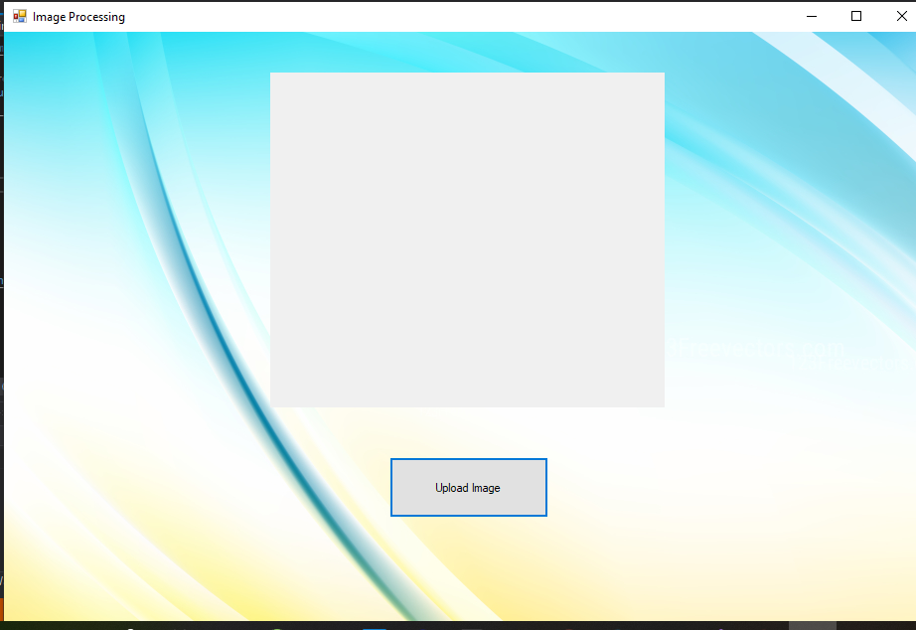
EXPECTED OUTPUT

Slide 11
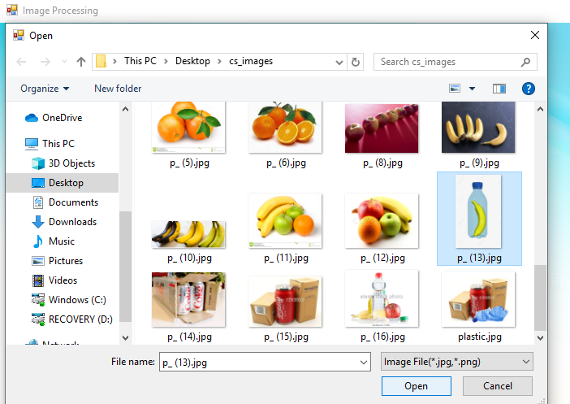
EXPECTED OUTPUT

Slide 12
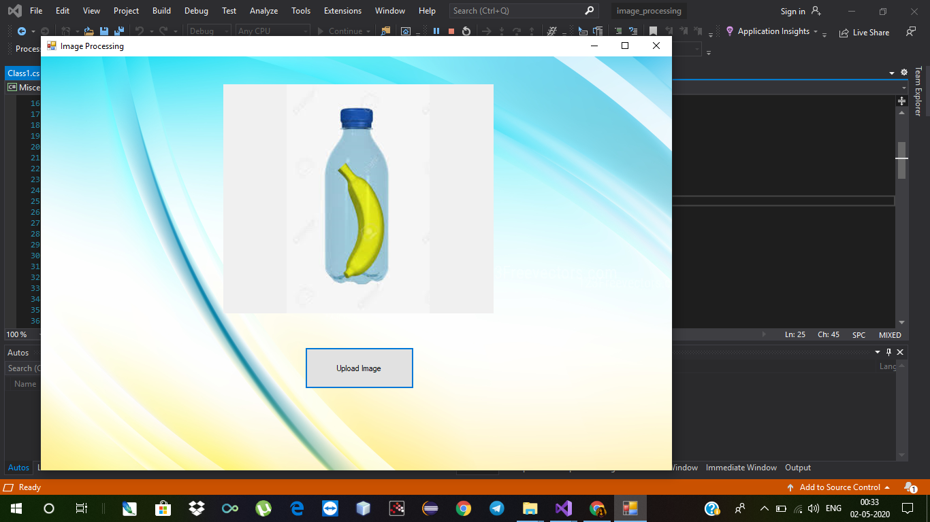
EXPECTED OUTPUT

Slide 13
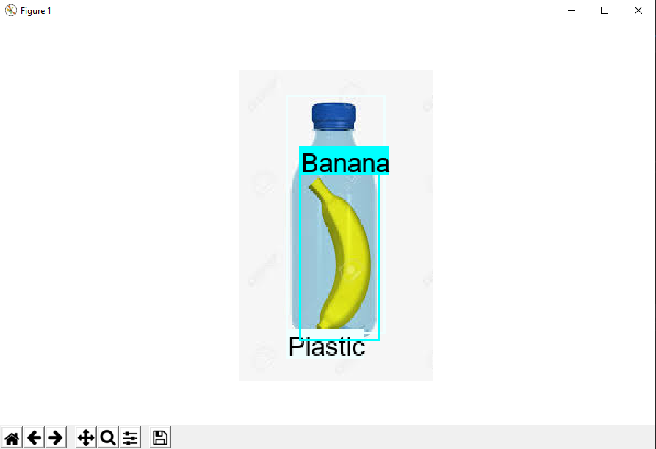
EXPECTED OUTPUT

Slide 14
Thank You

